Slide 1
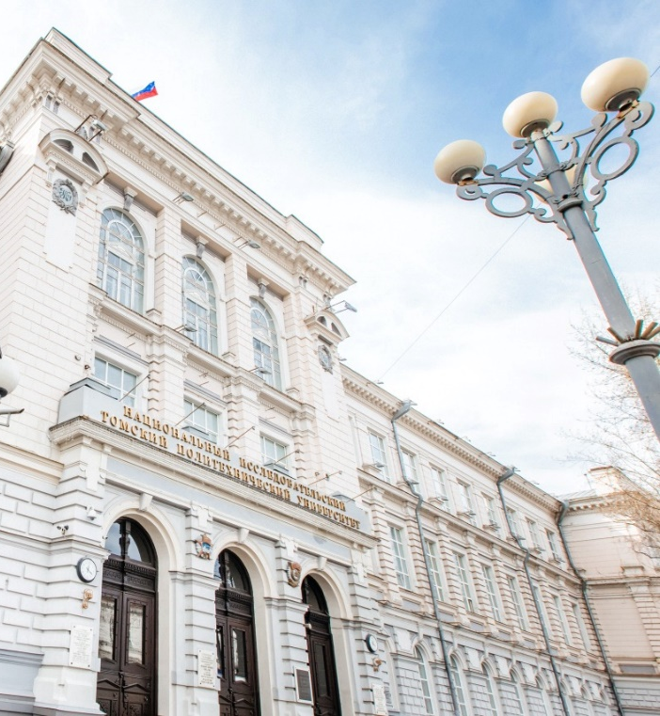
National Research
Tomsk Polytechnic University
Leonid Sukhikh
Acting Rector

Slide 2
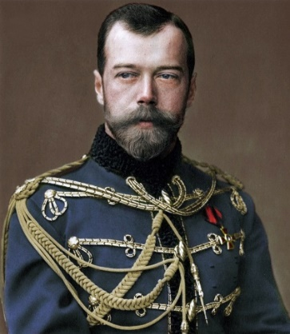
ABOUT TPU
On May 11, 1986
Emperor Nicholas II signed a decree establishing the Technological Institute of Practical Engineers in Tomsk
Sergey Witte, Minister of Finance of the Russian Empire,
who conceived the idea of a Technological Institute in Tomsk
Dmitri Mendeleev, active member of the committees
for the development of the institute project
Pyotr Stolypin, Chairman of the Council of Ministers of the Russian Empire, said during his visit to Tomsk Technological Institute in September 1910:
"The Institute is well equipped, practical classes predominate in all subjects of the curriculum".
CATEGORY – National Research
University (since 2009)
2013–2021 – participant in the Project 5-100, aiming to foster the competitiveness of leading Russian universities
In 1997, TPU was included in the List of the Most Valuable Objects of Cultural Heritage of the Peoples of Russia
2021 – participant in the Priority 2030 Program of the Ministry of Science and Higher Education of Russia, Research Leadership Track

Slide 3
TOMSK POLYTECHNIC UNIVERSITY
RANKINGS
QS World University Rankings 2023
398
11,553 students, including 2,517 international students from 38 countries
811 postgraduate students
1,230 academic faculty
3,555 total staff
30 bachelor’s programs and 5 specialist programs
34 master’s programs
3,573 state-funded slots in 2023 (bachelor’s, specialist, master’s and postgraduate)
World University Rankings by Subject
14
Engineering – Petroleum
(1st in Russia)
Global Ranking of Academic Subjects
9
151–200
Mechanical Engineering
Moscow International University Ranking The Three University Missions
258 (10th in Russia)
The Three University Missions rankings by subject:
1
Chemical Engineering
2
Nuclear Physics & Technology
1
Energy, Power Engineering and Electrical Engineering
3
Oil & Gas Engineering

Slide 4
UNIVERSITY STRUCTURE
Research Schools
Researchers – PhD holders
Publications
Academic reputation
Subject rankings
Research School of High-Energy Physics
Research School of Chemistry & Applied Biomedical Sciences
Integrated master’s-to-postgraduate programs
World-class fundamental research
Engineering Schools
Advanced Engineering School Smart Energy Systems
School of Non-Destructive Testing
School of Advanced Manufacturing Technologies
School of Computer Science & Robotics
Highly qualified engineers
State-of-the-art technologies
R&D revenue
Reputation among employers
School of Core Engineering Education
School of Earth Sciences & Engineering
School of Energy & Power Engineering
School of Nuclear Science & Engineering
Engineering master’s programs
Applied postgraduate programs
Engineering solutions
Business School
Tech startups
Income from business assets
Income from enterprises
Innovative environment
Applied Master’s in Entrepreneurship
Corporate Education
MBA, MTA, Presidential Management Personnel Pool Program

Slide 5
EDUCATION
7
network bachelor’s programs
60 bachelor’s degree programs
8 specialist degree programs
2,100+
online courses for full-time and extramural programs
1
network specialist program
240+
virtual simulators for full-time and extramural studies
89 master’s degree programs
25
network master’s programs
63 postgraduate programs
32 doctoral programs
250+
advanced training programs
39
professional development programs
6,900+
students completed continuing education programs
STUDENT NUMBERS 11,533, including
2,517 international students from 38 countries

Slide 6
EDUCATION
1.
Networking project of International Engineering Institute of Shenyang University of Technology and Tomsk Polytechnic University
Admission 2022
257 students
4 programs
Programs
Mechanical Engineering
Materials Science and Technology
Instrumentation Technology
Computer Science and Engineering
2.
Bachelor's 3+1 Program in Physics with Jilin University
Number of students:
180
3.
Project of International Center for Nuclear Education at TPU providing:
a full range of English-taught programs in nuclear power engineering and nuclear medicine (bachelor's, master's, and postgraduate) for foreign nationals
development and delivery of international advanced training courses and programs, professional development programs for foreign nationals tailored to the needs of Rosatom, IAEA, and national nuclear agencies of foreign countries
programs to promote Russian nuclear education in Africa, Latin America and South-East Asia

Slide 7
SCIENCE
TPU is in the top 10 Russian universities for R&D funding capacity
Total R&D volume is over 2,3 billion RUB
Extra-budgetary funds – 1,3 billion RUB
Annually, up to 250 million RUB are allocated for youth science, 80 % of which are from programs and grants.
Each year, TPU students receive more than 780 grants and scholarships based on the results of international, Russian and regional competitions of research projects and graduation theses.
PUBLICATIONS – 990 WOS-indexed articles, including 570 articles published in Q1, Q2 journals
1,266 SCOPUS-indexed articles, including 795 articles published in Q1, Q2 journals
Postgraduate numbers:
Admission:
255 – postgraduates
202 – state-funded
53 – self-funded
93 – internationals
75 % – with research background
Thesis defense:
136 – completed postgraduate programs
78 – candidate’s theses
10 – doctoral theses

Slide 8
TPU IN THE PROGRAM OF THE MINISTRY OF SCIENCE AND HIGHER EDUCATION OF RUSSIA
ENERGY OF THE FUTURE
HEALTHCARE ENGINEERING
NEW ENGINEERING EDUCATION
The project addresses conventional fossil fuels, advanced energy (nuclear and fusion energy, renewable energy sources), and frontier hydrogen energy.
It aims to create new technologies, set up expert and tech centers for the design of policies, norms and standards governing these fields, as well as to provide staff training.
The project aims to create the Federal Technology Reference Center for Healthcare Engineering specializing in ionizing radiation technology in radiology, radiotherapy, and nuclear medicine. It will facilitate the implementation of TPU developments.
The project will shape the framework and environment for the creation and testing of new models of engineering education in Russia.
The project is designed to consistently reassemble educational programs at the university, explore and test new tools and models of engineering education, and disseminate best practices together with leading engineering universities of Russia.

Slide 9
TPU IN THE FEDERAL PROJECT – UNIVERSITY TECHNOLOGY ENTREPRENEURSHIP PLATFORM
Startup Studio of Tomsk universities
TRACKS
ECOSYSTEM OF STUDENT TECHNOLOGY ENTREPRENEURSHIP AT TPU
Energy
Biotechnology and Advanced Materials
IT, Electronics, Communications
Participants: university students
GOAL
to bring to market new tech businesses that have emerged at universities
Projects of the Ministry of Science and Higher Education with the support of the National Technology Initiative (NTI):
FOUNDERS
2022–2025
NTI accelerator – Startup Industry. Accelerator for engineers – 64 shortlisted projects
Entrepreneurial Boiling Point – more than 60 events in 3 months
Fund for Infrastructure and Educational Programs
Open Innovation Startup Studio
TPU
TSU
TUSUR
150 mln RUB investments
72 startup projects
25 startups
ECOSYSTEM PERFORMANCE
Industrial partners: Rostec, Gazprom Neft, Rosneft, Roscosmos and others
64 startups as graduation theses
22 (2) winners of the Student Startup Competition supported by Innovation Promotion Fund
3 grant winners from the Employment Center of Tatarstan for startup project implementation (100,000 RUB)
PROJECT COORDINATOR
TPU

Slide 10
STRATEGIC PARTNERSHIP
TPU is a flagship university
Annually, the demand for TPU graduates, both bachelor’s and master’s, is more than twice as high as the number of graduates.
Gazprom
Rosatom
Rosneft
ISS-Reshetnev
Microgen
System Operator of the United Power System
RAO Energy Systems of the East
>90 %
TPU has entered into more than 600 cooperation and collaboration agreements with enterprises and organizations of various forms of incorporation
Graduates are employed by the companies offering work placements
17 innovation development programs (IDPs) for state-owned companies
24 out of 36 technology platforms (TPs)
TPU PARTICIPATES IN

Slide 11
THANK YOU FOR YOUR ATTENTION

Slide 12
TPU IN THE PROGRAM OF THE MINISTRY OF SCIENCE AND HIGHER EDUCATION – ADVANCED ENGINEERING SCHOOLS
TPU ADVANCED ENGINEERING SCHOOL SMART ENERGY SYSTEMS (AES SES)
KEY CONCEPTS
GOALS UNTIL 2030
Advanced development of research and technology products
Professional master's degree in engineering
Convergence of fuel and energy businesses with education
Digital solutions for fuel and energy sector
Business-oriented approach
Involvement of partners in education management
Cross-sectoral ecosystem integrator – 2.5 bn for R&D
New gen engineers – 1,500 graduates
Teachers with hands-on experience – 100% academic staff, 15% from businesses
University transformation driver
High-Tech Companies
NUCLEAR POWER
OIL & GAS
ELECTRIC POWER
AES SES
Training new gen engineers with a focus on digital solutions for the fuel and energy sector
Engineering center
Cross-industry implementation of domestic IT products
Retraining of current engineers and teachers
Research and development, implementation support
Expertise and consulting
TOOLS
KEY PARTNERS
37 programs
12 research projects
8 new educational workspaces
4 IT spin-offs
Process and operation greenfield
AES SES office spaces at companies
Internships with industrial partners
Higher Education System
Network educational programs
Transfer of best practices
Internships with industrial partners
International educational programs

