Slide 1
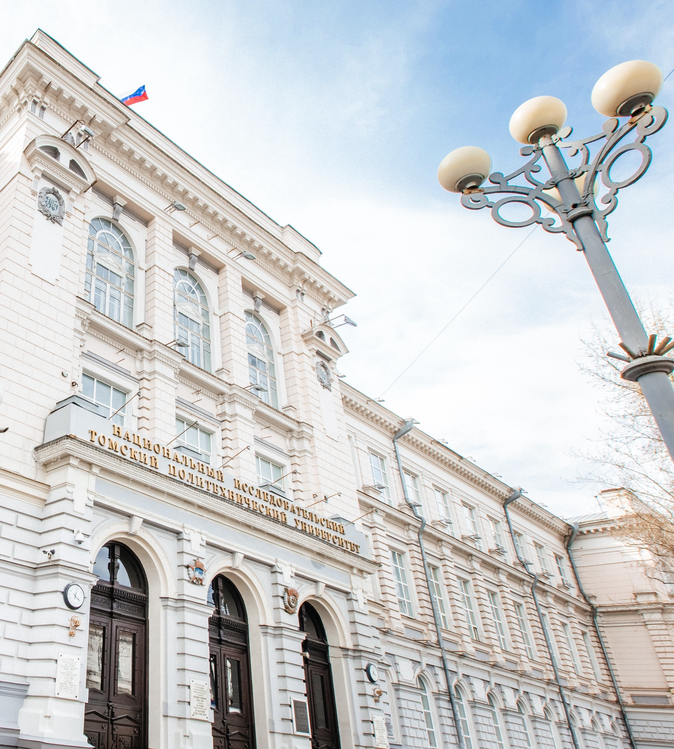

Tomsk
Polytechnic
University
Name
Position
Date

Slide 2

OUR WAY
1896
1904
1917-1934
1925-1927
1939
Establishment of the Technological Institute of Practical Engineers in Tomsk
Dmitri Mendeleev, the first honorary member of TTI
TTI – STI -ТII
Development of the Avietta STI-1, the first Siberian aircraft
Michail Usov, the first Siberian member of the Academy of Sciences
1900
1906
1923
1935
1944
Tomsk Technological Institute of Emperor Nicholas II, the first engineering institute in Russian Asia
first 16 graduated engineers
Establishment of the Research Institute of Applied Physics at TTI
Kirov TTI
Reorganized into Tomsk Polytechnic Institute
first 203 admitted students
1952-1955
1967
1997
2009
2021
TPI developed the equipment for the first TV broadcasting center beyond the Urals
Launch of the IRT-1000 research nuclear reactor
TPU was included into the List of the Most Valuable objects of Cultural Heritage of the Peoples of Russia
the National Research University category
Participant in the Priority 2030 Program
1947-1948
1958
1991
2001
2013
2022
Development of the first national betatron - a cyclic induction electron accelerator
Establishment of the Research Institute of Nuclear Physics, Electronics and Automation – the first TPI research institution
TPI was reorganized into Tomsk Polytechnic University
TPU opened the Center for Professional Training and Retraining of Oil and Gas Specialists in partnership with Heriot-Watt University
TPU ranked top 15 leading Russian universities
Participant in the Advanced Engineering Schools Program

Slide 3
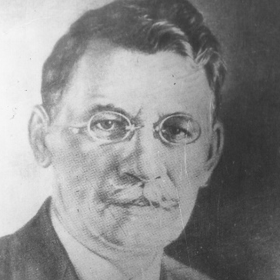
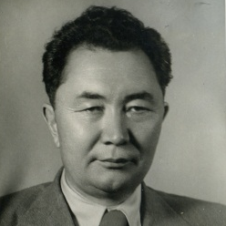
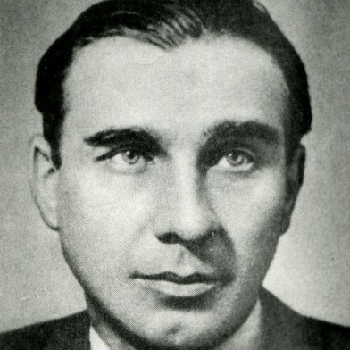
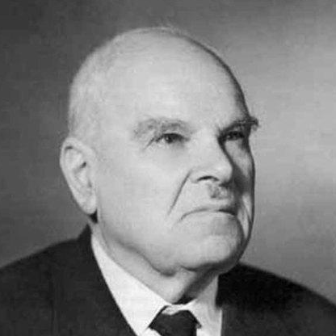
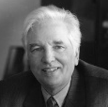
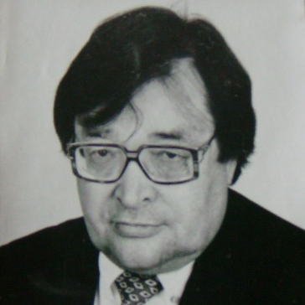
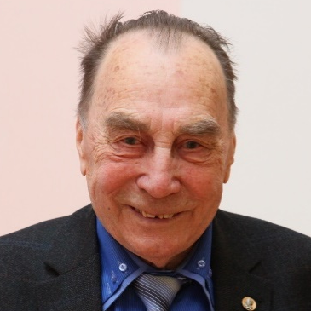
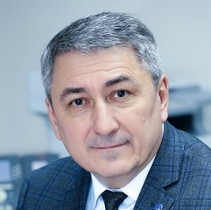
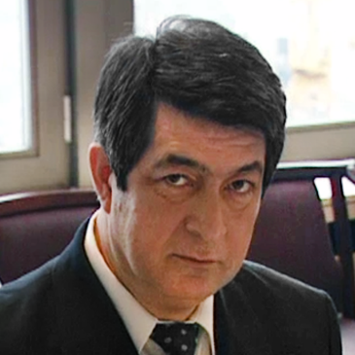
OUR CONTRIBUTION
200
thousand
Mikhail
Usov
Geologist (1908), Member of the USSR AS (1939)
Nikolai Urvatsev
Geologist (1919),
Arctic explorer
Kanysh Satpayev
Geologist (1926), Member of the USSR AS (1946)
Nikolai
Nikitin
Architect (1930), Associate member of USSR AS (1957)
Nikolai
Kamov
Aircraft designer (1923), helicopter developer
GEOLOGY
GEOLOGY
GEOLOGY
ARCHITECTURE
AIRCRAFT
ENGINEERING
Of engineers in 128 years
Gennady
Mesyats
Physicist (1958), Member of the AS (1984)
Vladimir
Nakoryakov
Physicist (1958),
Member of the AS (1987)
Vassily
Glukhikh
Physicist (1952),
Member of the AS (1987)
Alexandr Shutikov
Physicist (1984), CEO
of ROSENERGOATOM
Utkir
Sultanov
Electrical engineer (1963),
Prime Minister of the Republic of Uzbekistan(1995-2003)
HIGH CURRENT
ELECTRONICS
THERMAL PHYSICS
NUCLEAR PHYSICS
NUCLEAR POWER
ELECTRICAl
ENGINEERING

Slide 4




RANKINGS
QS World University Rankings 2025: Top global universities
576
top-25
World University Rankings by Subject
Engineering Petroleum
30
(1st in Russia)
12
RAEX Rankings by Subjects:
1
Chemical Engineering
3
Nuclear Physics & Technology
1
Energy, Power Engineering and Electrical Engineering
3
Oil & Gas Engineering

Slide 5








STRATEGIC PARTNERSHIP
TPU is a flagship university
TPU participates in
17 innovation development programs (IDP) for state-owed companies
24 out of 36 technology platforms
Gazprom
Rosatom
Rosneft
RESHETNEV Information Satellite Systems
Microgen
Russian Power System Operator
RAO ES East
TPU Strategic Partners
over 600 collaboration and cooperation agreements with enterprises and orgavizations of various ownership forms
Gazpromneft
ROSCOSMOS
ALROSA Group
Rosseti Energy Company
Rostec
SIBUR
Gazprom Transgaz Tomsk
Siberian Chemical Plant

Slide 6



UNIVERSITY STRUCTURE
RESEARCH SCHOOLS
Integrated Master’s-to-PhD programs
World-Class fundamental research
MegaScience Projects
SCHOOL OF SOCIAL SCIENCES
Research School of High-Energy Physics
Research School of Chemistry & Applied Biomaterial Sciences
Researchers – PhD holders
Publications
Academic Reputation
Humanities and social sciences in engineering training
Advanced training in soft skills development
Interdisciplinary studies in humanities and social sciences
ENGINEERING SCHOOLS
Engineering master’s programs
Applied postgraduate programs
Engineering Solutions
School of Advanced Manufacturing Technologies
School of Computer Science & Robotics
School of Earth Sciences & Engineering
School of Energy & Power Engineering
School of Nuclear Science & Engineering
SMART ENERGY SYSTEMS ADVANCED ENGINEERING SCHOOL
Highly qualified engineers
Advanced technologies
R&D revenue
Reputation among employers
BUSINESS SCHOOL
Applied Master’s in Entrepreneurship
Corporate training
MBA, MTA, Presidential Program for Management Training
Training of the next generation engineers based on digital solutions in the fuel and energy sector
Cross-industry implementation of domestic IT products
R&D for digital solutions in energy industry
Entrepreneurs
Corporate training
Development of the entrepreneurial environment
Startup community

Slide 7
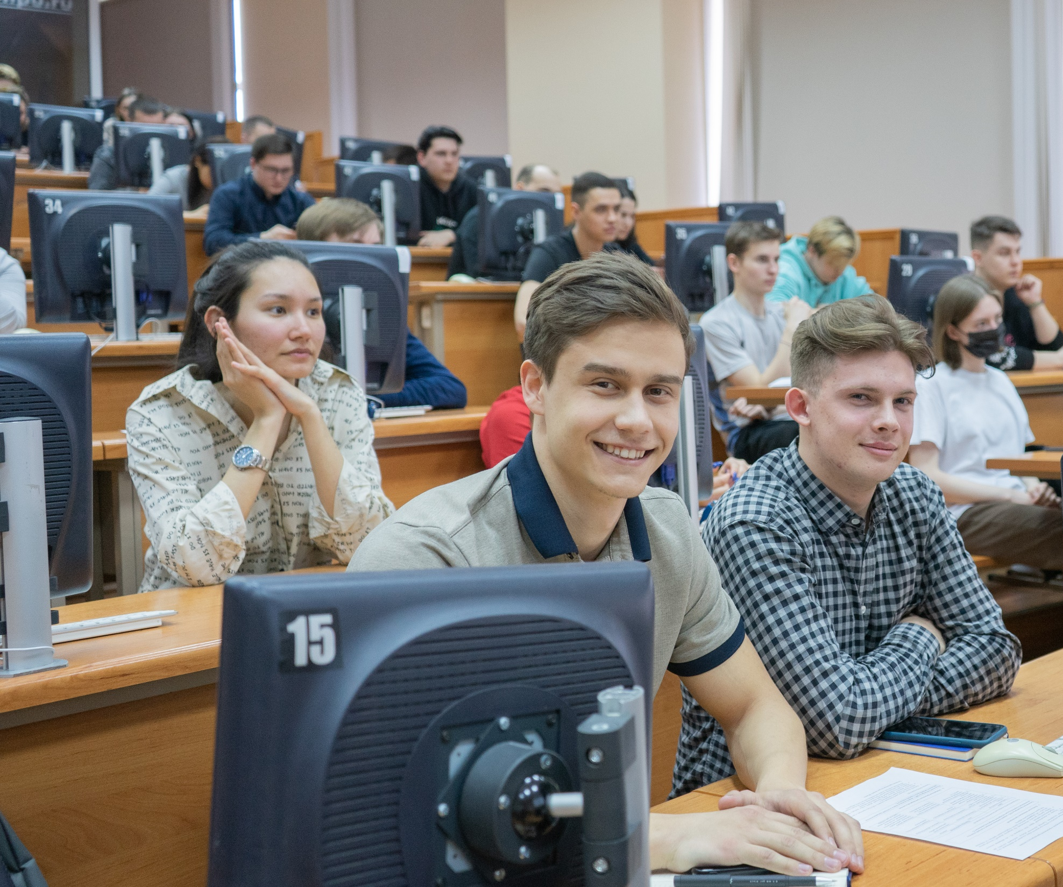
Education

Slide 8

EDUCATION
STUDENTS AND GRADUATES
Full-time students
undergraduates 58%
Master students 27%
13 500+
students and postgraduates
Specialist students 9%
Postgraduates 6%
EDUCATION MODEL
19%
fee-based
21,8%
from foreign countries
DIGITAL DEPARTMENT
ENGAGEMENT OF BUSINESSES AND EXPERTS
Fundamental subjects
Industry-specific and cross-industry modules
Program orientation course
Specialization modules
2 100
graduates annually
Fundamental engineering subjects
CAREER-ORIENTED ACTIVITY
ENGAGEMENT OF HIGH SCHOOL STUDENTS
Final thesis
Individual project
Team project
Individual research
The annual demand for the TPU graduates (specialists and masters) more than twice exceeds their number.
Practical training
Humanities and social sciences in engineering training
Sport training
93,1 %
of graduates get work assignment
Patriotic education & Volunteering, student entrepreneurship
2-3 YEARS
1-2 YEARS
1–2 YEARS

Slide 9
EDUCATION
STRUCTURE OF TRAINING PROGRAMS
38
bachelor’s degree programs
8 specialist’s degree programs
11
network bachelor’s programs
2600+
online courses
250+
for full-time and extramural programs
71
master’s degree programs
32
network master’s programs
63
postgraduate programs
32
doctoral programs
14
advanced training programs to develop digital competences (TPU Digital Department)
285
advanced training programs
84
professional development programs
11 100+
students completed continuing education programs
(Facts & Fig. 2024)

Slide 10
EDUCATION
INTERNATIONAL COOPERATION
Number of international students
INTERNATIONAL academic PROJECTS
Admission
564
Number of students
2396
Number of countries
63
1.
Networking project of International Engineering Institute of Shenyang University of Technology and Tomsk Polytechnic University
38
818 students
4 programs
2.
Academic program in Condensed Matter Physics with Jilin University
25 partner universities in academic exchenge
Annual admission 60 students
Number of students 144
Number of graduates 230
Joint Academic programs
(5 universities of China):
Jilin University (since 2006)
Shenyang University (since 2007, Joint Engineering Institute since 2022)
Henan University of Science and Technology (since 2017)
Chongqing College of Arts and Sciences (since 2017)
Donghua University (since 2020)
3.
International Center for Nuclear Education at TPU
5 advanced training programs
91 graduate and postgraduate students
100+ students completed continuing education programs

Slide 11

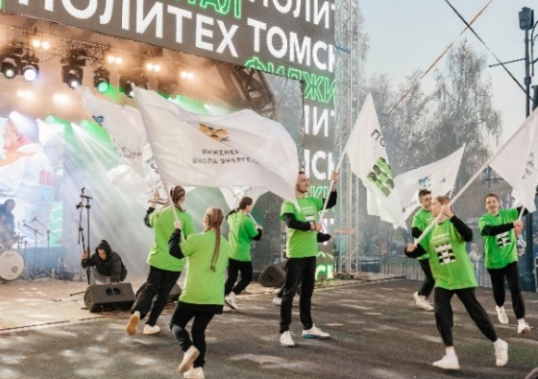
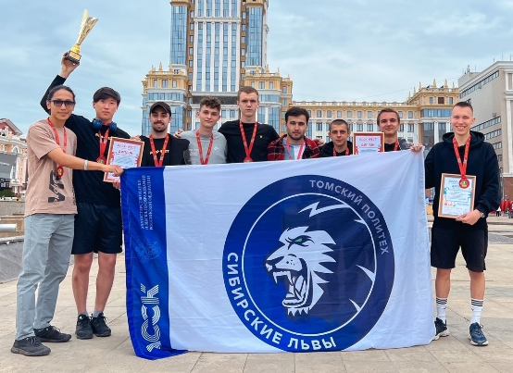
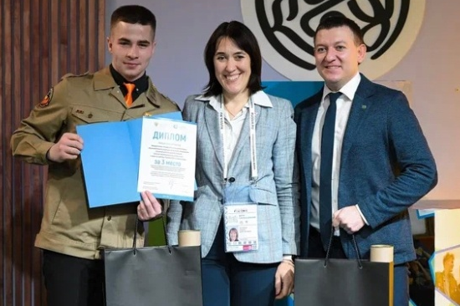
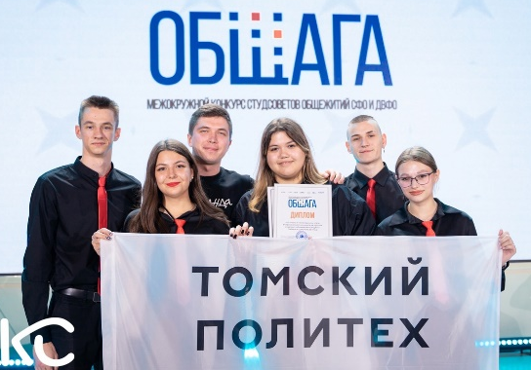
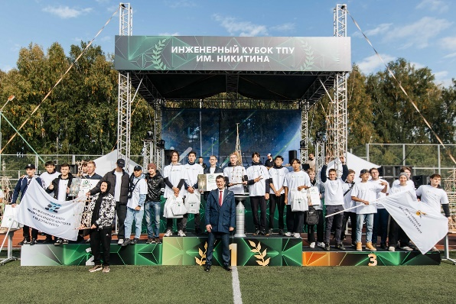
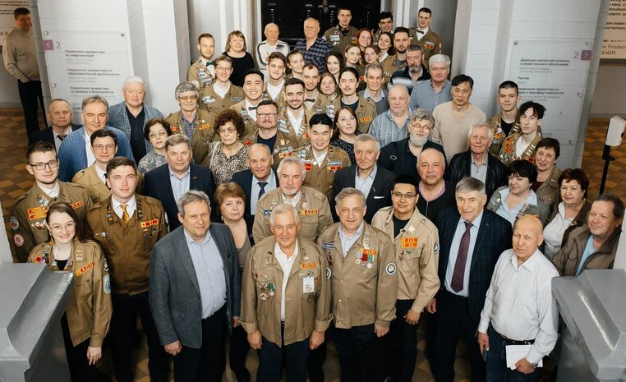
EDUCATION
EXTRA-CURRICULAR ACTIVITIES
16
student clubs
(1500 students)
700
events
(over 8 000 people)
23
teams
in 18 sports disciplines
RUB 1.36mln from Rosmolodezh grants
RUB 130.0mln attracted for the implementation of the I am in Business project
3rd place in the All-Russian competition of the Ministry of Education and Science for the best HE headquarters and 1st place among Tomsk universities
1st place for Educational Emergency Aid project in Best Practice of the Student Council in Organizing the Education Quality Management System in Russia
1st place for Siberian Lions – the best student sports club in the Russian Federation
Grand Prix in the All-Russian Student Media Hackathon "First Frames" from the Russia – Land of Opportunity platform
Amazonki – the best tourist club in the Russian Federation – the winner in the All-Russian Student League of Sports Tourism competition
The platform supported by the Ministry of Education and Science in the implementation of the Federal I am in Business project for the development of youth entrepreneurship
The Decade of Russian Language and Culture is the best practice of organizing youth policy and educational activities by the Ministry of Education and Science
The first engineering competition, the Nikitin Cup, was held among first-year students (over 1800 people)

Slide 12
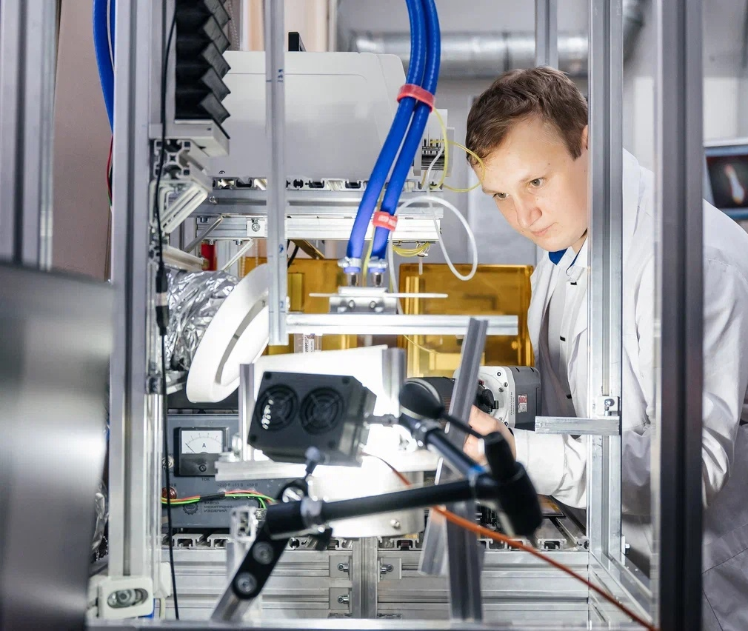
Science

Slide 13

SCIENCE
METRICS
TPU ranks among the TOP-10 Russian universities in the amount
of funds attracted for R&D
PUBLICATION ACTIVITY
R&D totals more than RUB 2.82bn
869 publications indexed
in WOS, 426 – in Q1, Q2 journals
Up to RUB 350mln are attracted annually to support youth science, with about 80% of the funds received through programs and grants
The TPU extra-budgetary component exceeds RUB 2.09bn.
1003 publications indexed in SCOPUS, 491 – in Q1, Q2 journals

Slide 14



SCIENCE
AREAS OF SCIENTIFIC ACTIVITY
3 strategic projects
CLOSED-CYCLE Economy AND ENERGY EFFICIENNCY
SMART SYSTEMS FOR INDUSTRY SECTORS
HEALTH ENGINEERING
New technologies for nuclear engineering
Conventional energy and biofuels
Management of low-grade raw materials and waste
Promising materials technologies for power engineering
Distributed energy
Digital transformation of the chemical and oil and gas industries
Smart security systems
Additive technologies
Integrated automated systems and devices for the R&D sector
Nuclear medicine
Radiation therapy and radiosurgery
Early detection and rehabilitation

Slide 15
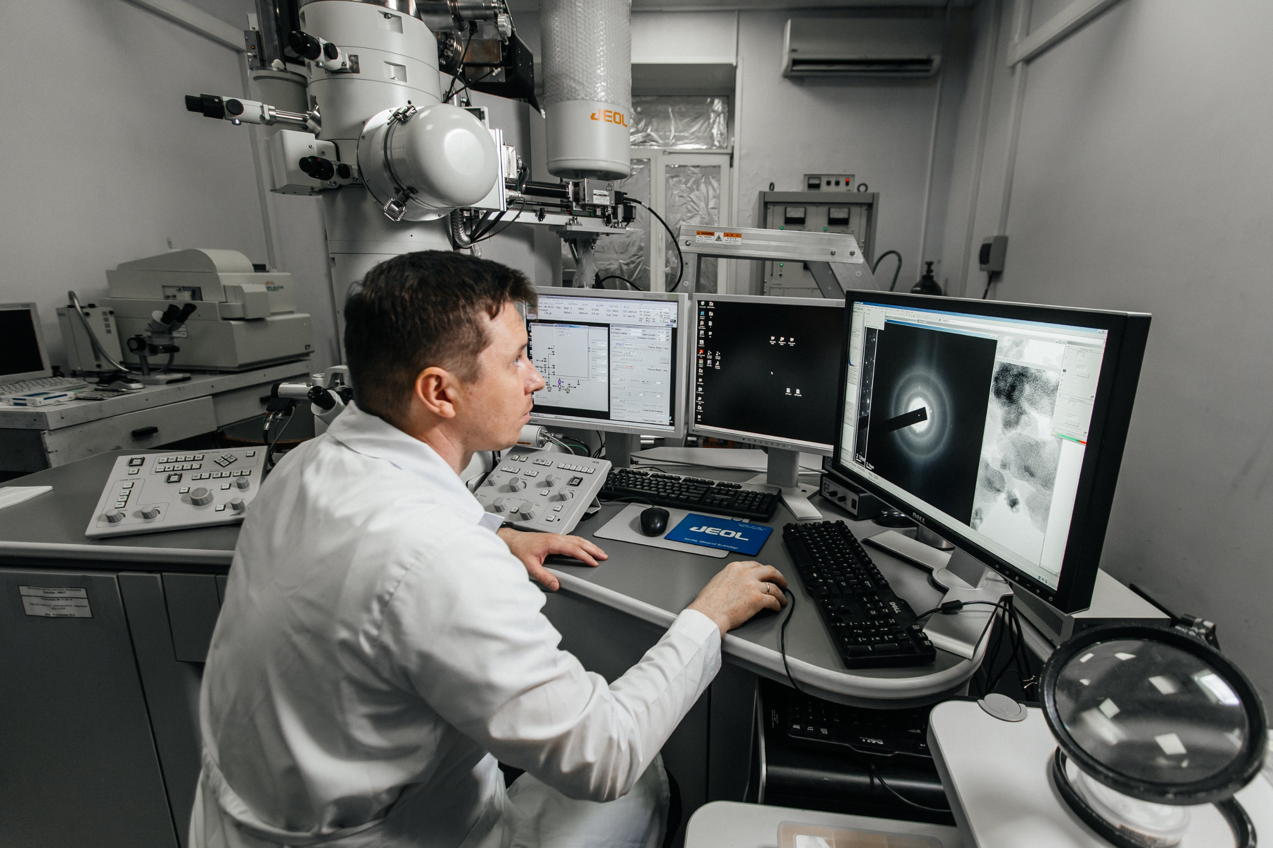
SCIENCE
TRAINING OF HIGHLY QUALIFIED PERSONNEL
848 post-graduates
240 enrolled in 2024
94 % scientifically advanced
63
postgraduate programmes
32
doctoral programmes
60
candidate theses defended
4
doctoral theses defended
3
PhD theses defended

Slide 16
SCIENCE
PUBLICATION ACTIVITY
DEVELOPMENT AND TECHNOLOGY
491 Q1/Q2 publications in WoS and Scopus
879 agreements, contracts and grants
12.1 % of TPU papers in the top 10% of the most cited papers in the world
1 733
RUB mln under business contracts
380.6 RUB mln in grants
242 employees h > 10
4.7 RUB mln under foreign contracts
Number of publications in Q1/Q2 journals by fractional count per one research AND ACADEMIC EMPLOYEE, pcs.
VOLUME OF FUNDS RAISED TROUGH INDUSTRIAL ORDERS (BY INDUSTRY SECTOR), RUB mln
Web of Science Scopus

Slide 17
SCIENCE
TECHNOLOGY ENTREPRENEURSHIP
TOP 6
HEIs in the field of Technology Entrepreneurship
TPU students annually receive more than 1000 grants and scholarships in international, Russian and regional competitions of research and final qualifying works.
2 startup accelerator programs
62 winners in the Student Startup competition
Trainings for entrepreneurial competencies
Entrepreneurial Boiling Point
Startup Studio
2 projects are piloted by an industrial partner
85 graduation theses in the form of a startup
32 projects within the Tomsk University Startup Studio (RUB 15.6 mln)
171 events within the Entrepreneurial Boiling Point
3 Federal Districts (trainings for TPU entrepreneurial competencies (StartTex: First Step into Business)
2 projects in the TOP-5 early stage projects according to the University Technology Entrepreneurship Platform

Slide 18
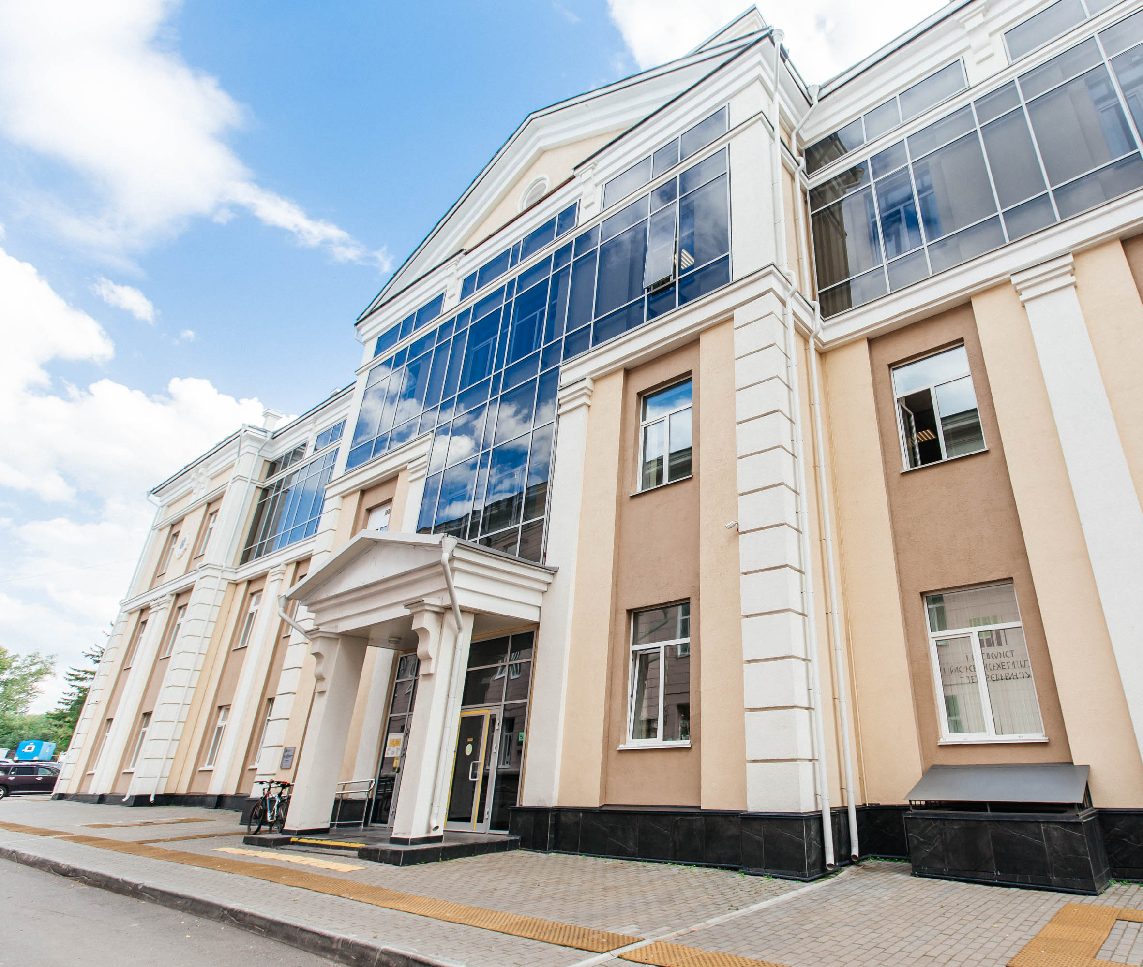
Infrastructure

Slide 19
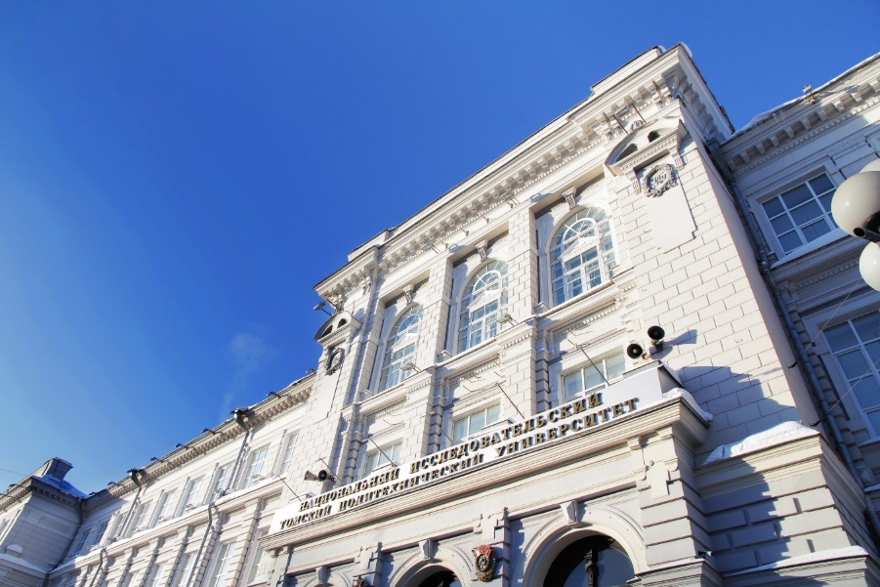
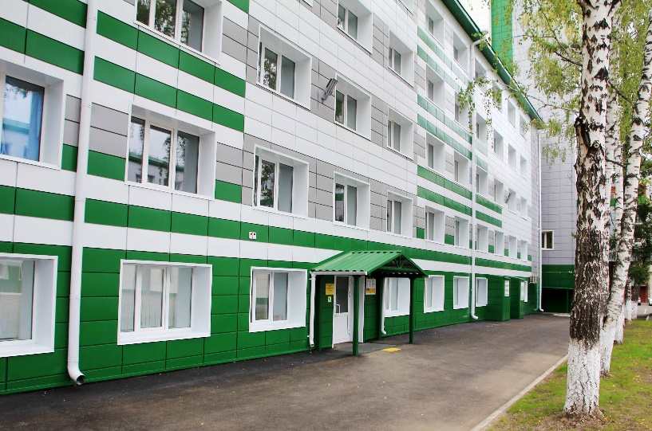
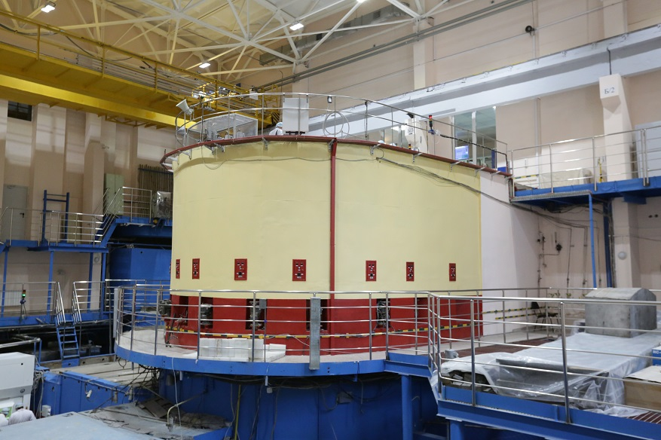
ИНФРАСТРУКТУРА
КАМПУС
ACADEMIC BUILDINGS
DORMITORIES
FACILITIES
Number —
Total area —
Heritage assets —
28
15
Number —
Total area —
Places —
Research Nuclear Reactor:
Buildings —
Total area —
Training Center for Geological Internships
in Khakassia
Children's health camp
Holiday camp
Sports sites —
152 sq.m.
92 sq.m.
8
33.5 sq.m.
27
6125
26

Slide 20

THANK YOU!

